Slide 1
SDOH & HiAP:
Helping community allies make sense of our alphabet soup
presentation to
PLACE MATTERS ACTION LAB
Las Cruces, NM
Friday, October 24, 2014
Jacque Garcia, Bernalillo County PLACE MATTERS TEAM
Monica Trujillo, Bernalillo County PLACE MATTERS TEAM
Marsha McMurray-Avila, Bernalillo County Community Health Council

Slide 2
What we’ll cover today…
Example of tool to review SDOH & HiAP
  Health in All Policies as approach to operationalize how to address the social determinants of health and equity
      Definition
      Context
      Key elements
  Strategies to implement Health in All Policies
  Identifying opportunities for cross-sector collaboration
Exploration of additional tools to promote active engagement of community coalitions in HiAP work
Exercise: Using Common Health Action's "Making the Case for Health Equity Planning Tool" to:
  Identify attitudes that may inhibit engagement of non-health community coalitions in HiAP work
  Identify communications strategies and tools to overcome resistance to participation
Notes:
What we’d like to cover today:
Provide an example of a tool that can be used to review the SDOH – in the form of a PPT presentation. Even for those who are already familiar with the SDOH, these slides can be used to introduce the concept to others. Slides 3-7 were created as part of a presentation to community health councils around New Mexico on social determinants and health equity. The remainder of the slides regarding HiAP were mostly taken from the HiAP Guide for State & Local Governments, with some other illustrative graphics interspersed.
We’ll take a look at some additional tools we’re putting into our toolkit, and are hoping you all may have ideas to add. (See www.nmpha.org for toolkit.)
We’ll do an exercise using CHA’s “Making the Case for Health Equity Planning Tool” to walk through a process that helps us figure out which tools to use in certain situations. (See HiAP at www.nmpha.org for a copy of the planning tool.)

Slide 3
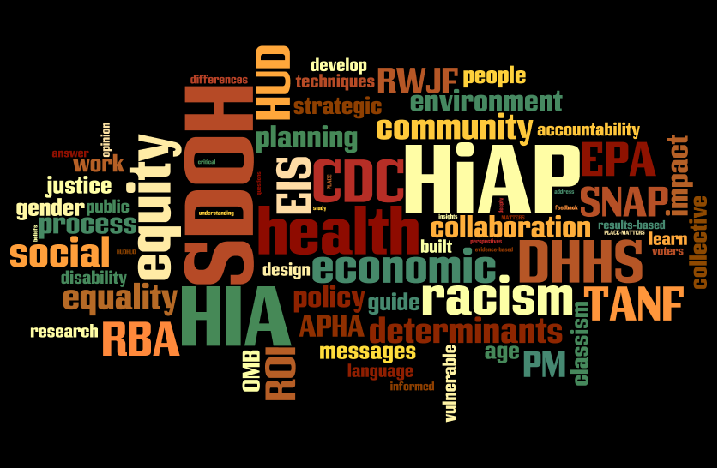
2014 NMPHA/M. McMurray-Avila
Notes:
So on to the alphabet soup – this is probably what the thought bubble looks like over our heads to folks in the community who don’t live in our community health world. And this is what my brain often feels like!
So let’s start to break it down…

Slide 4
What determines how healthy we are?
GENETICS
MEDICAL CARE
INDIVIDUAL BEHAVIORS
2012 NMAHC/M. McMurray-Avila
Notes:
Three things that come up most often when you ask people on the street “What determines how healthy you are?” There are lots of different versions of this out there, but do you want to say what you’ve heard in terms of the percentage each of these contributes? (Ask for thoughts/guesses from the audience.)

Slide 5
What determines how healthy we are?
GENETICS
MEDICAL CARE
5%
10%
INDIVIDUAL BEHAVIORS
30%
2012 NMAHC/M. McMurray-Avila
Notes:
So depending on which research or article you look at, it might come out something like this. Genetics I’ve seen as high as 10-15%, but medical care tends to usually be around 10%. At least a third is due to individual behaviors. Of course, the math whizzes in here are saying – wait that doesn’t add up to a 100. Right. There’s a big chunk missing. That other 55% or so is what REALLY determines how healthy we are…

Slide 6
What (really) determines how healthy we are?
2012 NMAHC/M. McMurray-Avila
Notes:
This is a long list of some of the most recognized social, economic, and environmental determinants of health. They’re small so in case you can’t see them (read the list)…
PICK SOME TO GIVE EXAMPLES (OR ASK FOR EXAMPLES) IF THERE’S ENOUGH TIME…
However, we also know that these social, economic and environmental determinants of health are greatly impacted by other social forces that determine the quality and resources available to individuals and communities in any of these areas. These are the Determinants of Equity…

Slide 7
Equitable Access & Opportunities for All
2012 NMAHC/M. McMurray-Avila
Notes:
We know that poverty, racism, classism, sexism and any other form of discrimination all have a major impact on the quality of the built environment all the way through this list down to the working conditions. For this reason, equity is a key principle and value to keep in mind in the following discussion of health in all policies.

Slide 8
SUMMARY: What is health and where does it come from?
Health is “a state of complete physical, mental and social well-being and not merely the absence of disease or infirmity.”
Public health is “what we as a society do to collectively assure the conditions in which people can be healthy.”
Those conditions can be described as the places where we live, learn, work, and play, and the social, economic and political factors that affect us in those places.
Notes:
In summary, here are a couple of definitions that help put this together.
The definition in the first bullet is from the World Health Organization (WHO).
The definition in the second bullet is from the Institute of Medicine.

Slide 9
That’s all great in theory…
How do we put it into practice?
“Health in All Policies” (HiAP) is a way to operationalize the understanding that our health is affected by multiple sectors of our society and those sectors all have a role to play in helping us get and stay healthy.
HiAP is a collaborative approach to improving the health of all people by incorporating health considerations into decision-making across sectors and policy areas.
HiAP, at its core, is an approach to addressing the social determinants of health that are the key drivers of health outcomes and health inequities.
HiAP is an approach, a process and a philosophy.
Notes:
So… a lot of words here and great concepts. But telling people about the social determinants of health or equity is not going to change health outcomes or make communities healthier. Health in All Policies is a way to actually operationalize this understanding of social determinants of health, and to recognize that we need all the different sectors that play a role in creating (or destroying health) involved in this work.
READ THIRD BULLET – so at its core this is an approach to addressing the social determinants of health that are the key drivers of health outcomes and health inequities. Several different ways of saying the same thing.
It’s also important to note that HiAP is an approach, a process and a philosophy. It is not a fixed step-by-step process or methodology like HIA. HIA is one tool that can be used in this process.
SO LET’S ADD A BIT MORE CONTEXT AND BACKGROUND…

Slide 10

Context…
The public health challenges of the 21st century are extremely complex, and solutions will require actions that go beyond the purview of public health, bringing together partners across policy areas and sectors.
Messy, wicked problems
Notes:
We all know the challenges we face. They’re extremely complex and the solutions go way beyond our public health boundaries. These kinds of complex problems are also known as wicked problems or social messes.

Slide 11
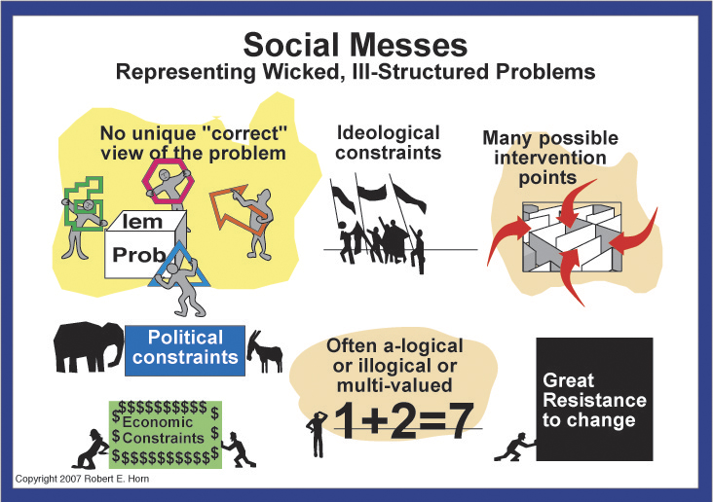
Notes:
Here’s a graphic look at why these are social messes. I’m sure you can relate with many of the problems you all deal with. (READ)

Slide 12
More Context…
Health in All Policies has gained significant traction in the last few years, but its origins go back over 35 years to the World Health Organization Declaration of Alma-Ata in 1978.
While public health has a long history of intersectoral collaboration, Health in All Policies is an emerging approach that aims to formalize the consideration of health in decision-making at all levels of government in order to promote healthy community environments and prevent adverse health impacts in the future.
Notes:
SO a little more context and history to emphasize that this is not a totally new idea…
Formalizing is the important key word here

Slide 13
HiAP – 5 Key Elements
Promote health, equity and sustainability
Support intersectoral collaboration
Benefit multiple partners
Engage stakeholders
Create structural or procedural change
Notes:
SO HiAP is this approach to get different sectors to collaborate on solving problems that affect our health by supporting healthy policies. So what are the key elements of the HiAP approach? READ

Slide 14
1. Promote health, equity and sustainability
HiAP promotes health, equity and sustainability
through two avenues:
Incorporating health, equity and sustainability into specific policies, programs, and processes, and
Embedding health, equity and sustainability considerations into government decision-making processes so that healthy public policy becomes the normal way of doing business. Promoting equity is an essential part of HiAP given the strong ties between inequity and poor health outcomes.
Notes:
The overall purpose or outcome of HiAP is to promote health, equity and sustainability. This can be done either at the level of individual policies, programs or processes OR by embedding into the actual government decision-making processes so that healthy public policy becomes the normal way of doing business. And promoting equity is always given a central role.

Slide 15
2. Support intersectoral collaboration
HiAP brings together partners from many sectors to:
recognize the links between health and other issue and policy areas,
break down silos,
build new partnerships to promote health and equity, and
increase government efficiency.
Notes:
#2 – This can only be done through collaboration across sectors… breaking down the silos and building new partnerships is key to this approach.

Slide 16

Breaking down silos…
LAND USE PLANNING
EDUCATION
ECONOMIC
DEVELOPMENT
TRANSPORTATION
Agencies that are not typically considered as health agencies play a major role in shaping the economic, physical, social, and service environments in which people live, and therefore have an important role to play in promoting health and equity.
Notes:
Think about those agencies that are not typically considered as health agencies and the role that they play in shaping the economic, physical, social and service environments in which people live. We clearly cannot promote health and equity without getting past this silo mentality and working together. This then leads us to think about the kinds of community coalitions/organizations that may interact with each of these different government sectors. That gives us an idea of who we in public health need to be connecting with.

Slide 17
3. Benefit multiple partners
HiAP is built upon the idea of “co-benefits” and “win-wins.” HiAP work should benefit multiple partners, simultaneously addressing the goals of public health agencies, other government agencies and community stakeholders to benefit more than one end (achieve co-benefits) and create efficiencies across sectors (find win-wins).
Notes:
But everyone in all these silos needs to feel that they’re benefitting. We need to find solutions that are “co-benefits” and “win-wins” – solutions that can have more than one positive outcome in more than one sector.

Slide 18
Co-benefits
Public health practitioners have a unique role to play in improving the quality of life in our nation, but genuine efforts to improve health must be made in partnership with other sectors.
The concept of co-benefits is essential for:
securing support from partners
reducing redundancies, and
ensuring more effective use of scarce government resources.
Finding a balance between multiple goals will sometimes be difficult, and requires negotiation, patience, and learning about and valuing others’ priorities.
AVOID PUBLIC HEALTH IMPERIALISM
Notes:
An additional word on co-benefits… Public health practitioners have a unique and vital role to play in this, but we can’t do it alone. And we have to make sure that all partners benefit in order to secure their support as well as to make the system work better and use our resources wisely. This isn’t easy. It’s difficult and requires negotiation, lots of patience and a deep understanding of what the priorities and values are of our partners.
In this, we have to avoid public health imperialism. I know myself, I want so badly for everyone to see themselves as working in public health (based on the broad definition). But our partners in other sectors also like to see themselves as the center of the world that everything else connects to. We won’t make friends or establish lasting relationships if we don’t accept that.

Slide 19
4. Engage stakeholders
HiAP engages a variety of stakeholders, beyond government partners, such as community members, policy experts, advocates, the private sector, and funders. Robust stakeholder engagement is essential for ensuring that work is responsive to community needs and for garnering valuable information necessary to create meaningful and impactful change.
Notes:
In the HiAP Guidebook for Local and State Governments they refer to “partners” as being other government agencies and “stakeholders” as those outside of government - like community members, policy experts, advocates, the private sector and funders. Whether we call them stakeholders or community partners, they must be engaged as a fundamental part of this work – both to insure that the work is responsive to community needs and to make sure we have all the information necessary for meaningful change.

Slide 20
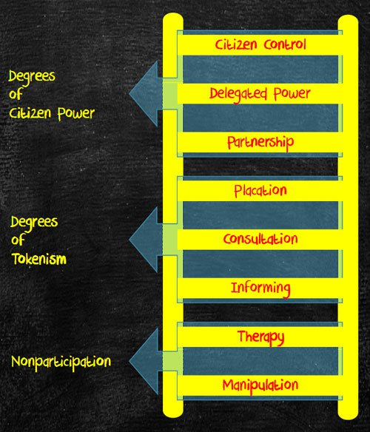
Notes:
This is one of the early depictions of the Ladder of Community Participation – this one by Arnstein started with a level of non-participation that included manipulation and therapy. And describes this middle section as “tokenism”

Slide 21
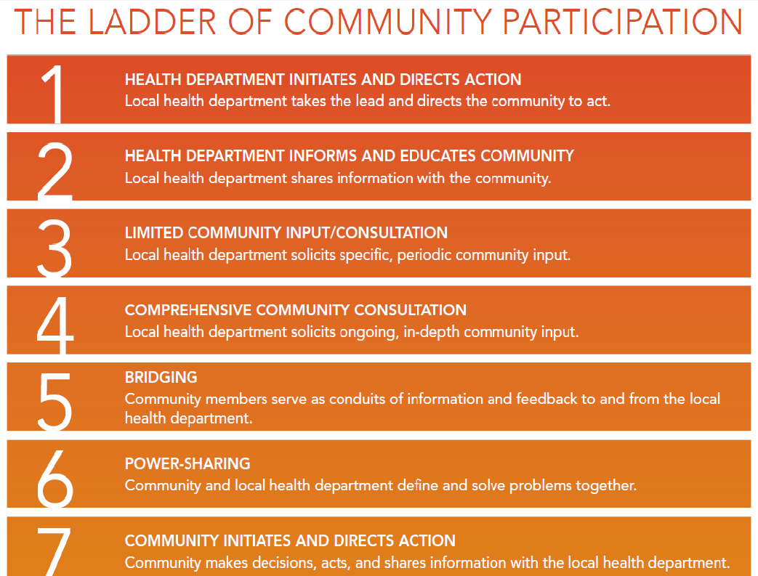
Notes:
A more recent version that is specific to health departments starts at the top ( in top-down form) with the health department pretty much making all the decisions and goes through several levels all the way down to where the community itself initiates the action and makes decisions – then sharing it with the health department. How do we find the best, most effective ways to work together for change?

Slide 22
5. Create structural or procedural change
Over time, HiAP creates permanent changes in how agencies relate to each other and how government decisions are made. This requires maintenance of:
structures which can sustain intersectoral collaboration
mechanisms which can ensure a health and equity lens in decision-making processes across the whole of government.
This can be thought of as “embedding” or “institutionalizing” HiAP within existing or new structures and processes of government.
Notes:
So the last element is that the goal of HiAP is to create permanent changes in how agencies relate to each other and how government decisions are made. This is where we talk of embedding or institutionalizing HiAP into the decision-making process.

Slide 23
Strategies for implementation
HiAP actions and groups can take many forms. It can be implemented through:
creation of a new structure or group
be applied to existing processes such as strategic planning and grant-making
or both
Many options exist for how to consider health in decision-making, from using formal health impact assessment tools to an informal application of a health lens. Partners, leaders, and focus areas will vary, depending upon political support, community needs, and resources.
Notes:
There are many ways this can be done. It could be through a new task force or other group or structure, or could be applied to processes already ongoing or both.

Slide 24
Where do we start?
Look for “Windows of Opportunity”
Opportunistic approach – Identify existing issues, policies or relationships that can provide early success for all partners
Issue approach – Identify policies that have major impact on specific public health priorities (e.g., violence prevention, hunger alleviation, or reduction of poverty)
Sector approach – Focus on one specific policy area with a large health impact
(e.g., transportation or agriculture)
Notes:
Three different “windows of opportunity” to start identifying how to inject HiAP into different processes… (READ and explain)

Slide 25

Opportunistic Approach:
Food for Thought…
Are there any existing or newly forming interagency initiatives that have potential health implications?
What single-agency initiatives would benefit from partnership with additional agencies?
Is your agency, or is another agency, going through a strategic planning process?
Is there a new or ongoing process where health metrics or data could be added?
What partners have you worked with successfully in the past?
Notes:
Looking at the Opportunistic Approach, here is some “Food for Thought” from the HiAP Guidebook for Local & State Governments that are questions you could ask.

Slide 26
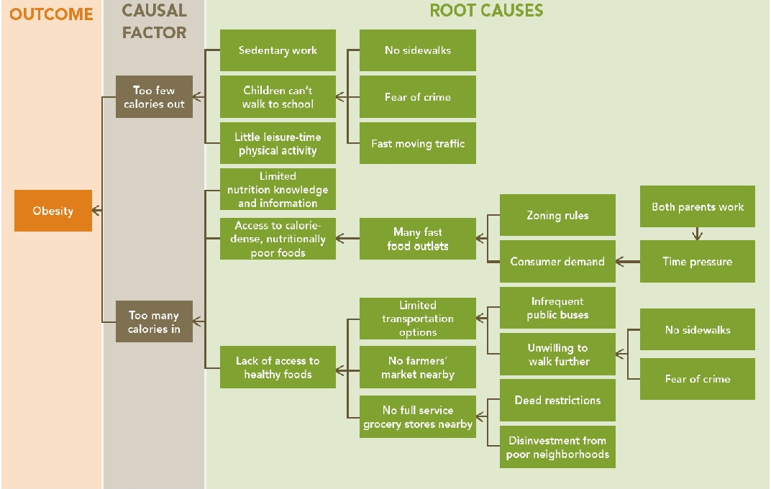
Issue Approach: Root Cause Map
Lack of physical activity
Lack of healthy food
Notes:
Here’s an example of how you can take one issue – like obesity – and then look at the root causes to the far right to get ideas of what sectors need to be involved. No sidewalks = which government agency? (Public Works); Fast moving traffic = which agency? (Traffic Engineering); Zoning rules = which agency? (Land Use Planning); Infrequent public buses = which agency? (Transit Department); Disinvestment in poor neighborhoods = which agency? (Economic Development). Etc, etc.

Slide 27
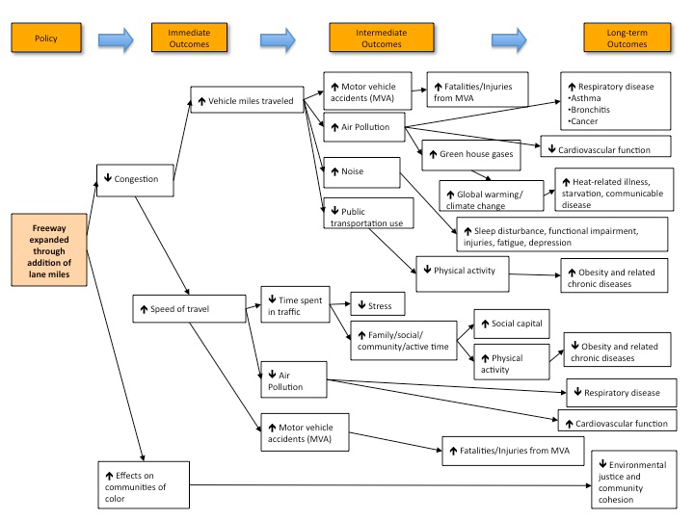
Sector Approach: Transportation
Notes:
For the Sector Approach, you could choose a sector, e.g., Transportation, and then through a pathways diagram help illustrate for partners in that sector all the different places that their work impacts on health. Human Impact Partners has multiple pathways diagrams such as these that can either be used as is to trigger dialogue with community members in coalitions, or could be created by members of a community coalition based on their issue.

Slide 28
Characteristics of successful collaboration
Identify a champion on the ground, such as a local coalition that might have an interest in the issue.
Build on past successes and define small wins that can be accomplished early, are politically and practically feasible, and have implications for health.
Use active listening.
Use a definition of health that addresses root causes.
Highlight what partners have to gain from participation and what you have to offer partners.
Create a shared understanding of a mutual goal that cannot be achieved alone.
Notes:
The next three slides are all included in a handout from ASTHO on Collaboration, so we won’t go over all of these here, but they bear discussing with your teams as you engage in collaboration.

Slide 29
Characteristics of successful collaboration
Become familiar with the other sector’s policy making processes, regulations, and any constraints that may impact the ability to act on health recommendations.
Identify shared goals and activities in statewide action plans.
Build trust through transparency, frequent meetings, and responsiveness to questions, concerns and limitations raised by non-health partners.

Slide 30
Characteristics of successful collaboration
Be realistic about short, intermediate, and long-term implementation plans.
Identify an immediate collaboration goal around an urgent, visible and important issue.
Build public support for collaboration through outreach and messaging.
Practice effective communication with sectors that may use different terminology.
Ensure meaningful participation from all key stakeholders represented in the process.
Share the credit for successes.
Monitor and evaluate success.

Slide 31
How does it all connect?
Tools to effectively implement HiAP:
Collective Impact
Results Based Accountability
Health Impact Assessments
And more to come…
Notes:
It’s always important to help people see how all the different tools out there can actually be used together. They complement each other and can all contribute to accomplishing our goals within a unified framework. It’s not a competition for which tool to use…

Slide 32

THANK YOU!
Now go break down those silos…

